Slide 1
NE 763: Advanced Reactor Materials
Fall 2025
Dr. Benjamin Beeler

Slide 2
Last Time
Austenitic steels undergo excessive void swelling in fast reactor conditions
F/M steels have good mechanical properties, are cheap, and their microstructure can be tailored through composition and fabrication
M23C6 and monocarbide precipitate are prevalent both along grain boundaries and within the grains; M2X metallic precipitates form and can be converted to Laves phases
F/M steels swell very little due to fundamental nature of defects in ferrite, C-vacancy bonding, and dislocation-solute interactions
Tailoring of alloying elements has allowed for improved creep strength
Stress induced preferential nucleation/absorption (SIPN – SIPA)
Swelling interaction with creep

Slide 3
Fe-Cr-al steels

Slide 4
FeCrAl
FeCrAl alloys are expected to have excellent high temperature corrosion behavior and very low void swelling, making them viable candidates for both LWR and advanced reactors
Strong push over the last 10 years to develop FeCrAl after Fukushima, including it as an accident tolerant fuel concept
Alloying additions are weighed to target properties and microstructure
Al allows for formation of Al2O3, limiting high T steam corrosion
Too much Cr leads to sigma phase and alpha’ which cause embrittlement, while too much Al leads to the formation of Al intermetallics
Cr and Al act as bcc stabilizers such that FeCrAl is fully ferritic
Other alloying species are added to increase strength, modify precipitation, etc.

Slide 5
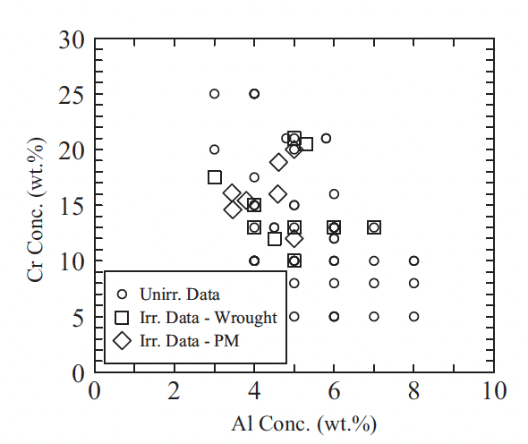
Compositional Limits
A range of alloys have been studied for radiation tolerance utilizing different fabrication techniques
Typically operate from 5-25 wt.%Cr and 2-8wt%Al
If too little Cr/Al is present, get poor high temperature corrosion resistance
To much Cr/Al, embrittlement and fabrication issues
To much of either Cr or Al, unfavorable precipitation behavior

Slide 6
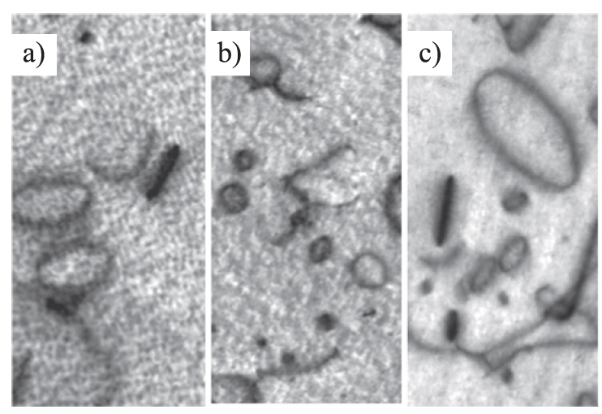
Irradiation Behavior
Effectively no void swelling has been observed up to 23 dpa and 600C
These alloys are expected to display excellent void swelling resistance characteristic of ferritic alloys
Both vacancy and interstitial loops of specific orientations are known to form, regardless of minor compositional variances
Loop size and density are impacted by composition and as-fabricated microstructure

Slide 7
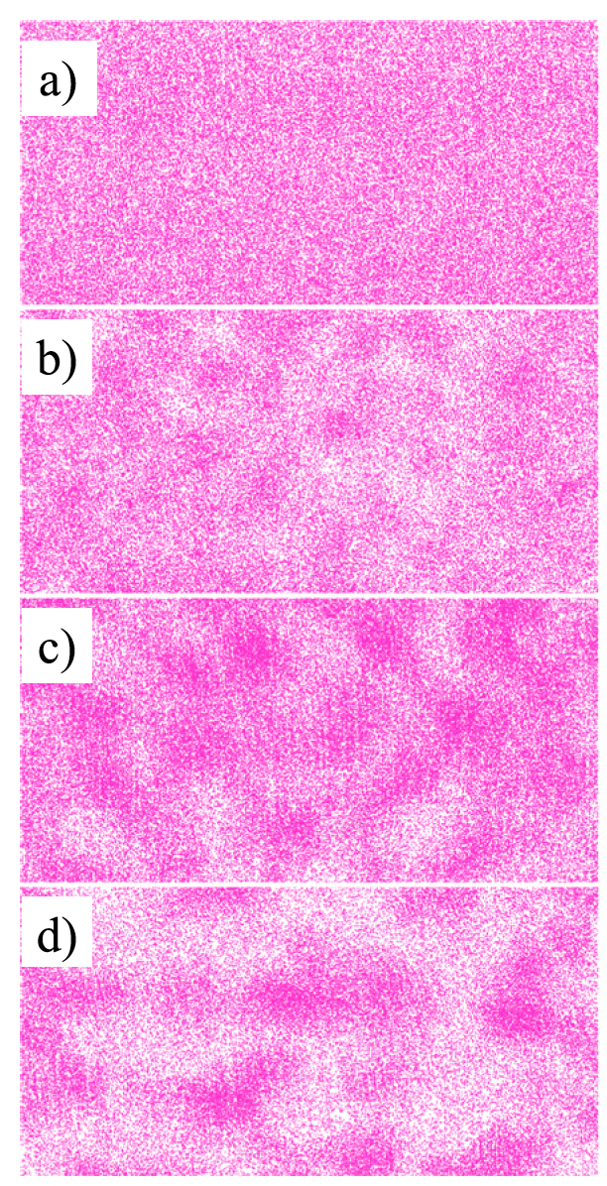
alpha’ Precipitation
Like other high-Cr ferritic alloys, FeCrAl alloys have been shown to be susceptible to irradiation-enhanced precipitation of the Cr-rich alpha’ phase
Embrittlement due to alpha’ formation has a high likelihood of being the primary factor dictating the useful lifetime of FeCrAl components
Aluminum is believed to inhibit, but not prevent, alpha’ precipitation
Irradiation enhanced diffusion accelerates the Cr precipitation, reducing the temperature and Cr-content at which alpha’ is expected to form
Atom probe tomography Cr atom maps during neutron irradiation

Slide 8
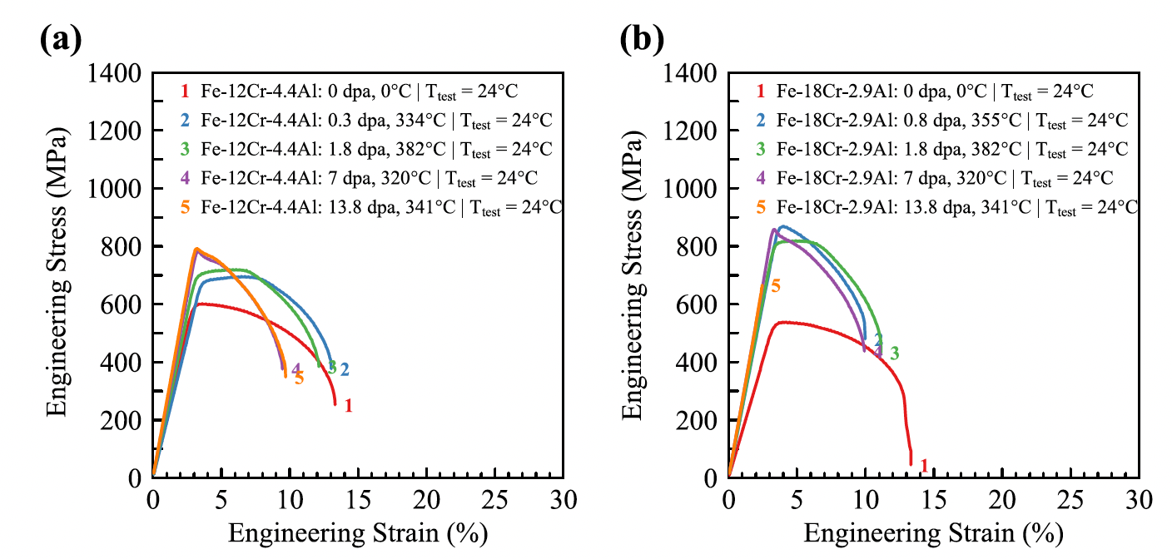
Irradiation Hardening
FeCrAl shows pronounced increases in yield strength and corresponding decreases in total elongation due to dislocations and alpha’ precipitates
The general trend is an initial regime where the yield strength steeply increases with increasing dose and then reaches a saturation
Saturation is typically around 10% elongation
Some high-Cr alloys have shown a third stage of complete embrittlement

Slide 9
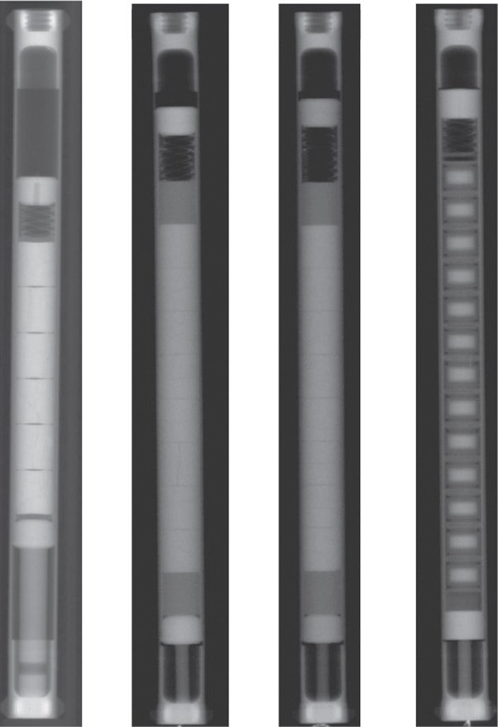
Integral Experiments
FeCrAl is still relatively poorly explored in integral expts
Only a handful of irradiation+corrosion tests; only a handful of fueled cladding tube tests
No major issues identified, but nothing extended to high burnup or transients
So, it is a promising material, but still a long way to go to verify its suitability

Slide 10
ODS Steels

Slide 11
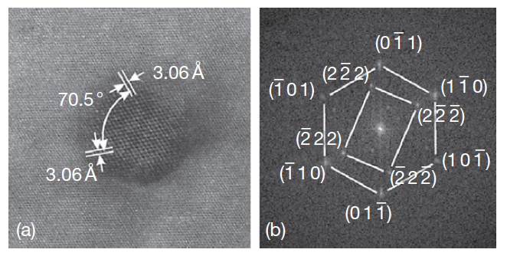
Oxide Dispersion Strengthened
Thermally stable oxide particles dispersed in the ferritic matrix improve the radiation resistance and creep resistance at high temperature
ODS steels have a strong potential for high burnup and high temperature applications typical for SFR fuels
Allow the system to retain essentially a fixed microstructure with irradiation
Typically, Y2O3 particles or Y2Ti2O7 particles
HRTEM of Y2O3 particle with surrounding matrix

Slide 12
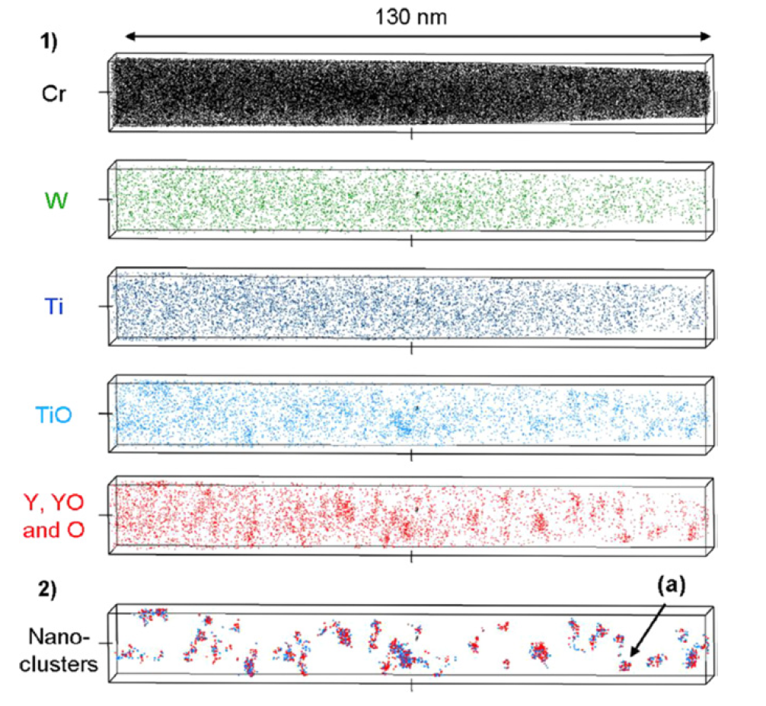
Y2O3 Decomposition
The fine distribution of Y2O3 particles is attained by the dissociation of stable Y2O3 particles which are forced to decompose into the ferritic steel matrix during the mechanical alloying process
The lattice structure change of Y2O3 in the ODS steel during MA consists of three stages: (1) destruction of the lattice structure, (2) formation of a blurry lattice structure, (3) appearance of amorphous areas
Particles precipitate under heat treatment

Slide 13
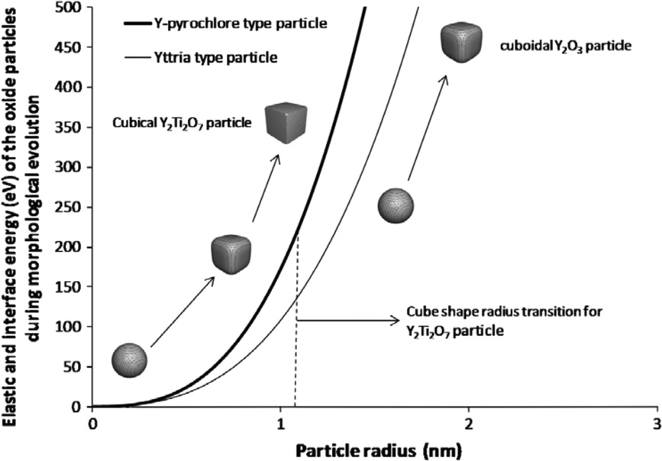
Oxide Particle Structure
The structure of the nanoparticles depend on sintering temperature and time, excess oxygen concentration, etc.
Particles usually evolve from spheroids to cuboids with time/size
Interfacial energy increases with particle size
Misfit strain typically increases with particle size

Slide 14
9Cr-ODS
For nuclear applications, the choice of 9 wt% Cr with a tempered martensitic matrix is preferable to suppress the ductility loss by irradiation hardening and improve the microstructure stability and creep strength at high temperature
The high-temperature strength of 9Cr is drastically improved by nano-scale oxide particles dispersion in the matrix
The standard chemical composition of 9Cr-ODS being developed by the JAEA for SFR application is 9Cr–0.13C–0.2Ti–2W– 0.35Y2O3 (wt%)
The addition of titanium produces the nanoscale dispersion of oxide particles
Tungsten of 2 wt% is also added to improve high-temperature strength via solid solution hardening

Slide 15
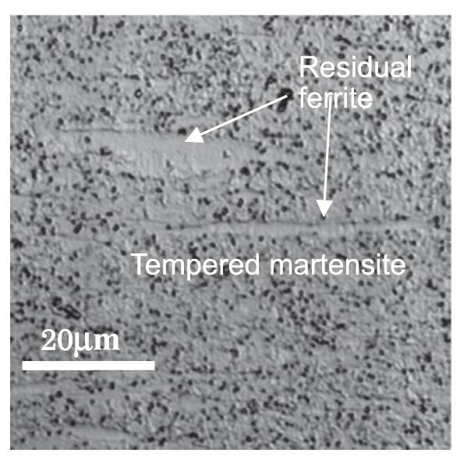
9Cr-ODS microstructure
The microstructure of 9Cr-ODS steel cladding is basically tempered martensite, but includes some residual ferrite phases
Only the full martensite phase can be expected in 9Cr-ferritic steel without yttria under the same conditions
The high temperature strength is greatly improved with the ferrite, and thus control of ferrite is key in ODS fabrication

Slide 16
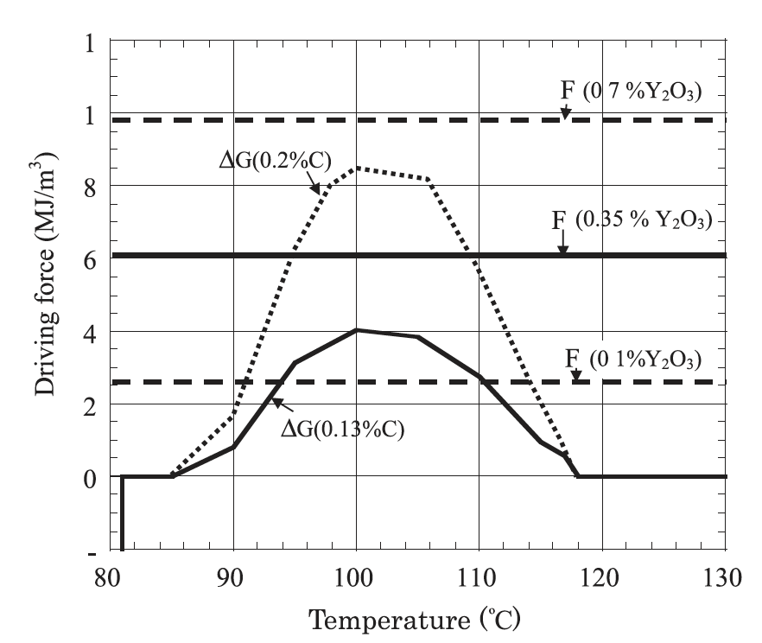
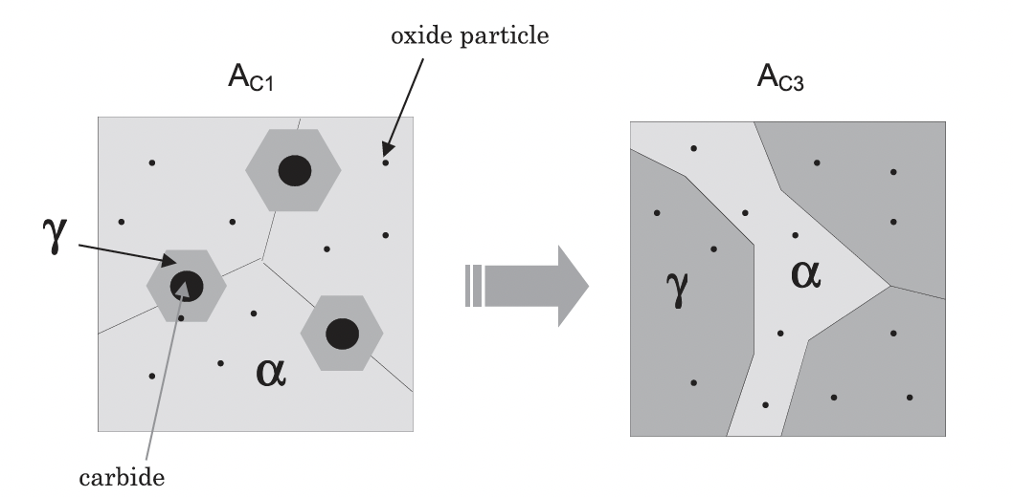
Residual Ferrite
Annealing results in the formation and precipitation of Y–Ti complex oxide particles
This heat treatment should convert ferrite into austenite, but when Y2O3 is present, we retain ferrite at high temperature and through quenching
These oxide particles block the motion of the alpha-gamma interface, there by partly suppressing the reverse transformation from alpha to gamma-phase

Slide 17
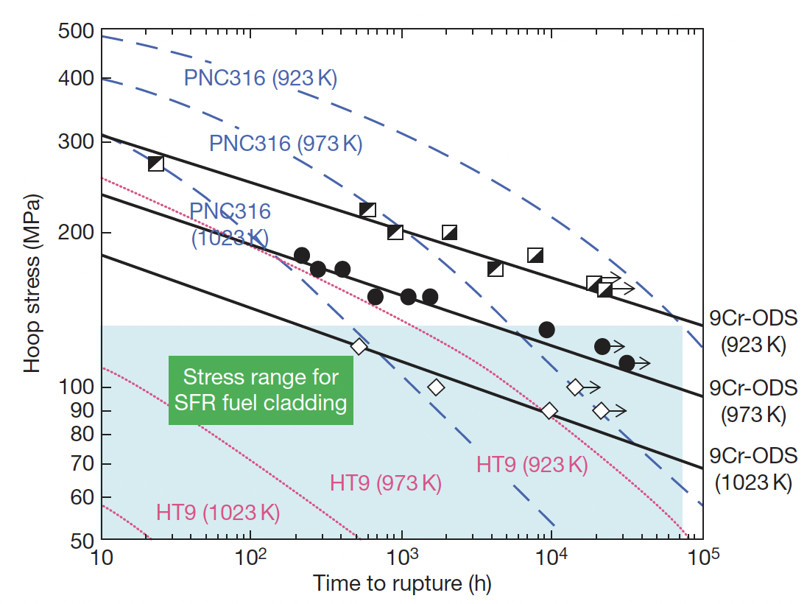
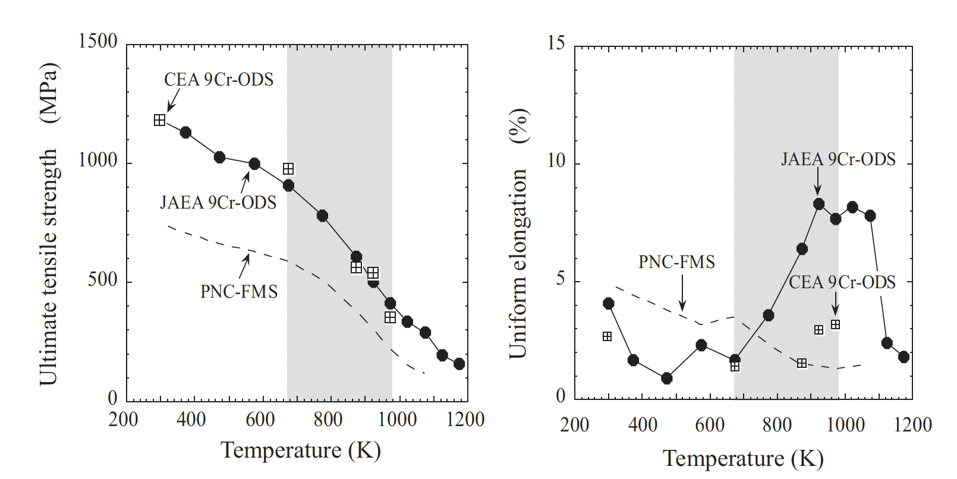
Mechanical Properties
The lifetime of a SFR cladding is mostly determined by the internal creep rupture strength with the internal pressure of the fission gas at a temperature of ~700C
PNC316 is austenitic steel used developed by JAEA for fast reactors
PNC-FMS is a F/M steel
9Cr-ODS steels have superior creep resistance and higher tensile strength

Slide 18
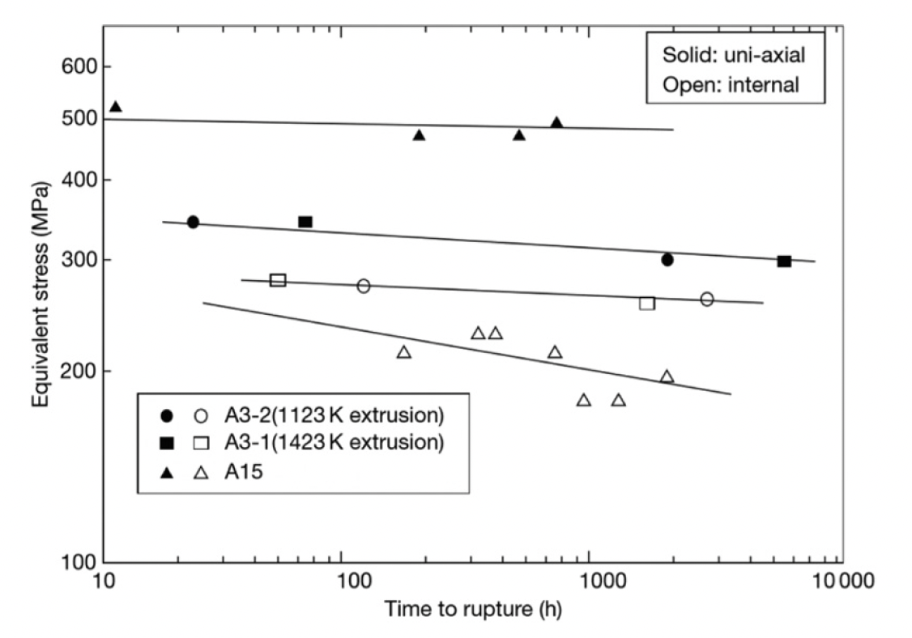
Ferritic 12Cr-ODS Steel
Development of ODS steels began with purely ferritic types, similar to MA957
While these types of steel exhibit excellent creep rupture resistance, there is anisotropy of the rupture strength
Can form elongated grains due to fabrication, weakening cladding in hoop direction
If the Y2O3 content is kept sufficiently low, an equiaxed grain structure can be maintained, providing more isotropic mechanical properties
Creep rupture strength of recrystallized (A3) and unrecrystallized (A15) 12Cr-ODS steels at 650C

Slide 19
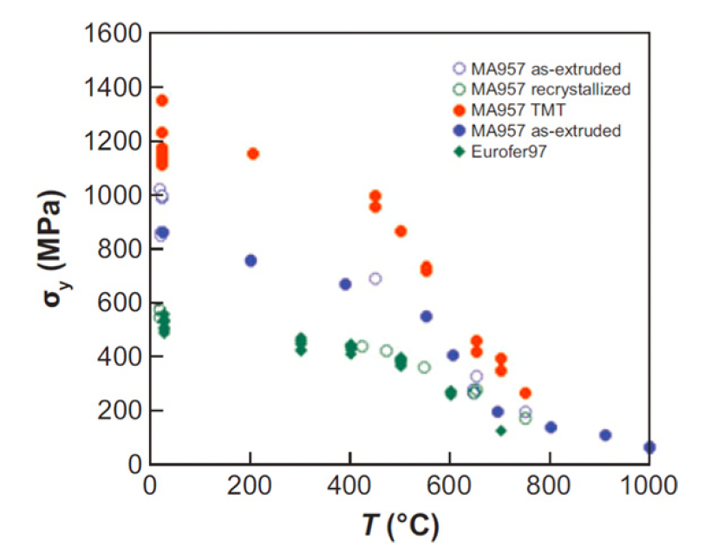
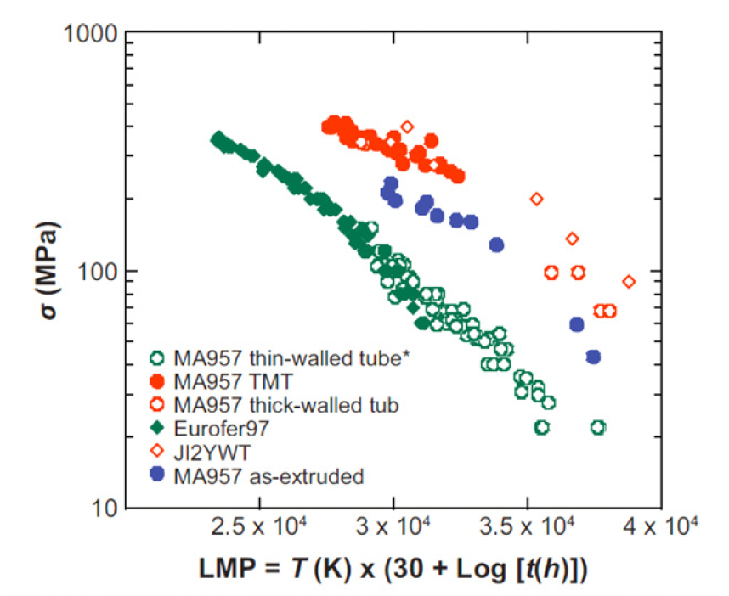
NFAs
Nanostructured ferritic alloys (NFAs) are 12%–20% Cr ferritic stainless steels that are dispersion strengthened by a very high density of ultrafine Y-Ti-O nanofeatures
This high density creates fine grain and dislocation structures
This can yield excellent strength and radiation resistance, but make fabrication processes very difficult
MA957 is a NFA, Eurofer is a tempered martensitic steel

Slide 20
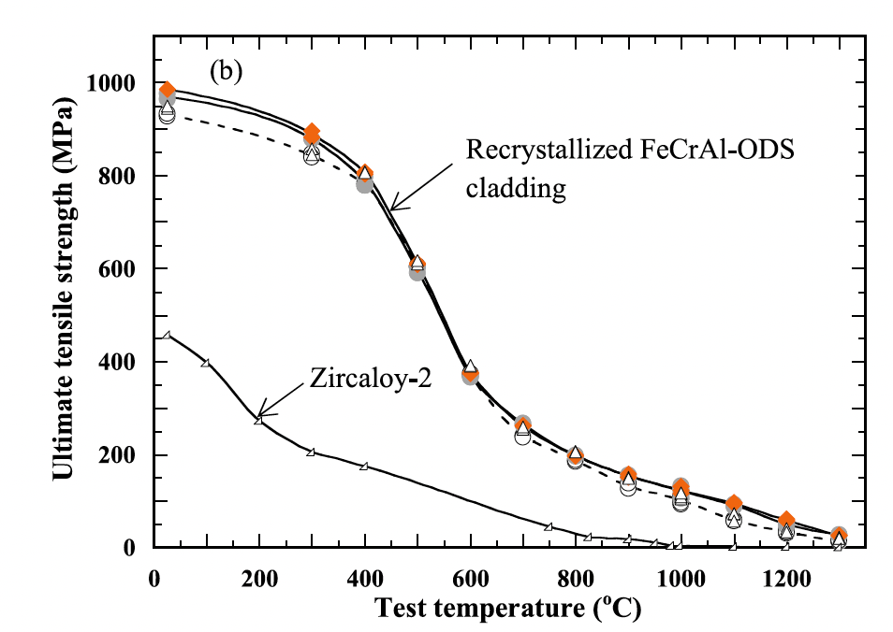
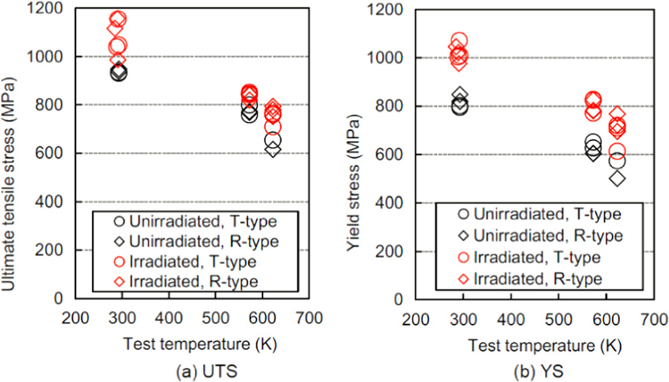
FeCrAl-ODS Steel
FeCrAl steels, with and without ODS are of interest since Al-containing steels produce the stable alumina (Al2O3) scale to prevent direct reaction of Fe with steam
A nominal composition of Fe-10Cr-6.1Al-0.3Zr (wt%) with 0.3wt% Y2O3 has been studied by ORNL, a number of different alloys explored by JAEA program
Zr is added to prevent ‘large’ Y-Al oxide particle formation
The creep rupture strength of Zr-added FeCrAl-ODS cladding is beyond the existing 9CrODS and 12CrODS steel claddings for fast reactors

Slide 21
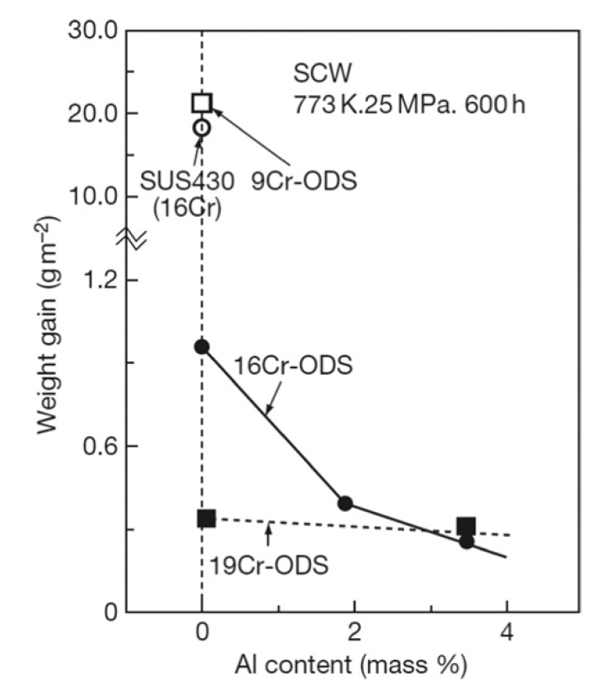
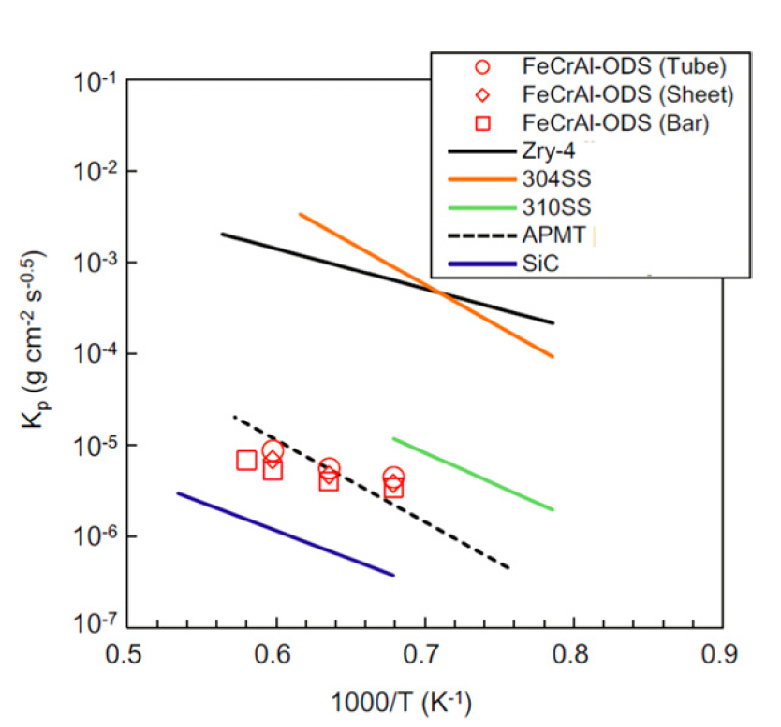
Corrosion
Hot steam oxidation tests are fairly limited in ODS steels
Additional Cr improves corrosion resistance, and Al content greater than 2 wt% provides a protective barrier
Excess oxygen content in the alloys can serve to suppress corrosion
In systems with high amounts of excess oxygen, Zr content can further aid in corrosion resistance

Slide 22
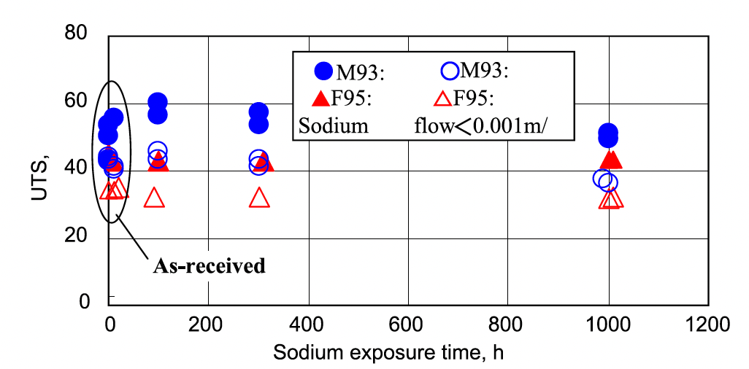
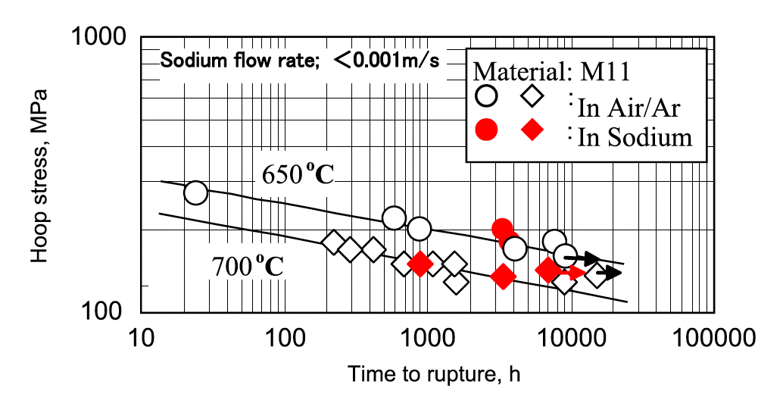
Liquid Na Compatibility
OSD-steels display excellent compatibility with liquid sodium
Both 9Cr and 12Cr ODS steels show no degradation in UTS after prolonged exposure to Na
Creep rupture behavior of ODS steels in air is identical to that in liquid Na
Under irradiation, this corrosion behavior may change, but has not been thoroughly studied

Slide 23
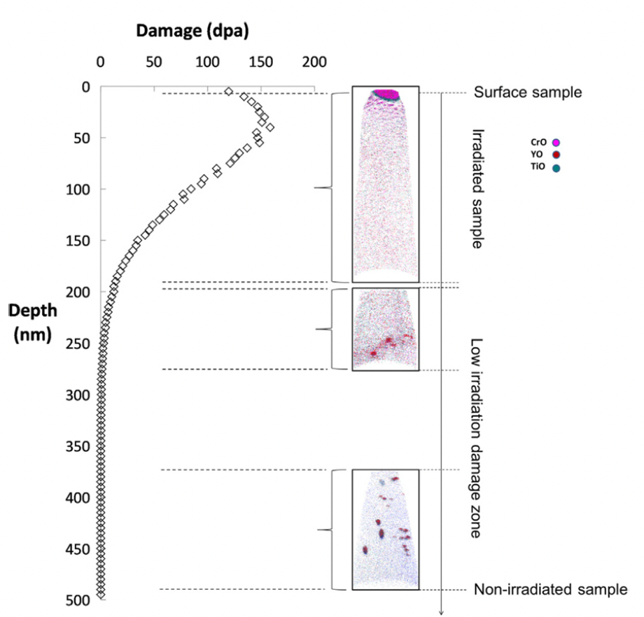
Irradiation Effects
The stability of the oxide particles under irradiation is the key factor in these alloys maintaining their advantageous mechanical properties under operation
Ballistic dissolution-the ejection of atoms from oxide particles due to high energy PKAs and the disordering of the particles-changes the nature of particles under irradiation
Complete dissolution of particles has been observed via APT

Slide 24
Irradiation Effects
At higher temperatures where vacancy diffusion is possible, ballistic dissolution works in conjunction with irradiation-assisted diffusion and changes the oxide particles
The atoms ejected from oxide particles can diffuse back to the original oxide particles, stay in the matrix, or reach other oxide particles
Most studies have reported that the size and number density of the oxide particles hardly change compared to how they were before irradiation
The predominant mechanism of of recovery is the back diffusion to the original oxide particles or re-joining to other existing oxide particles

Slide 25
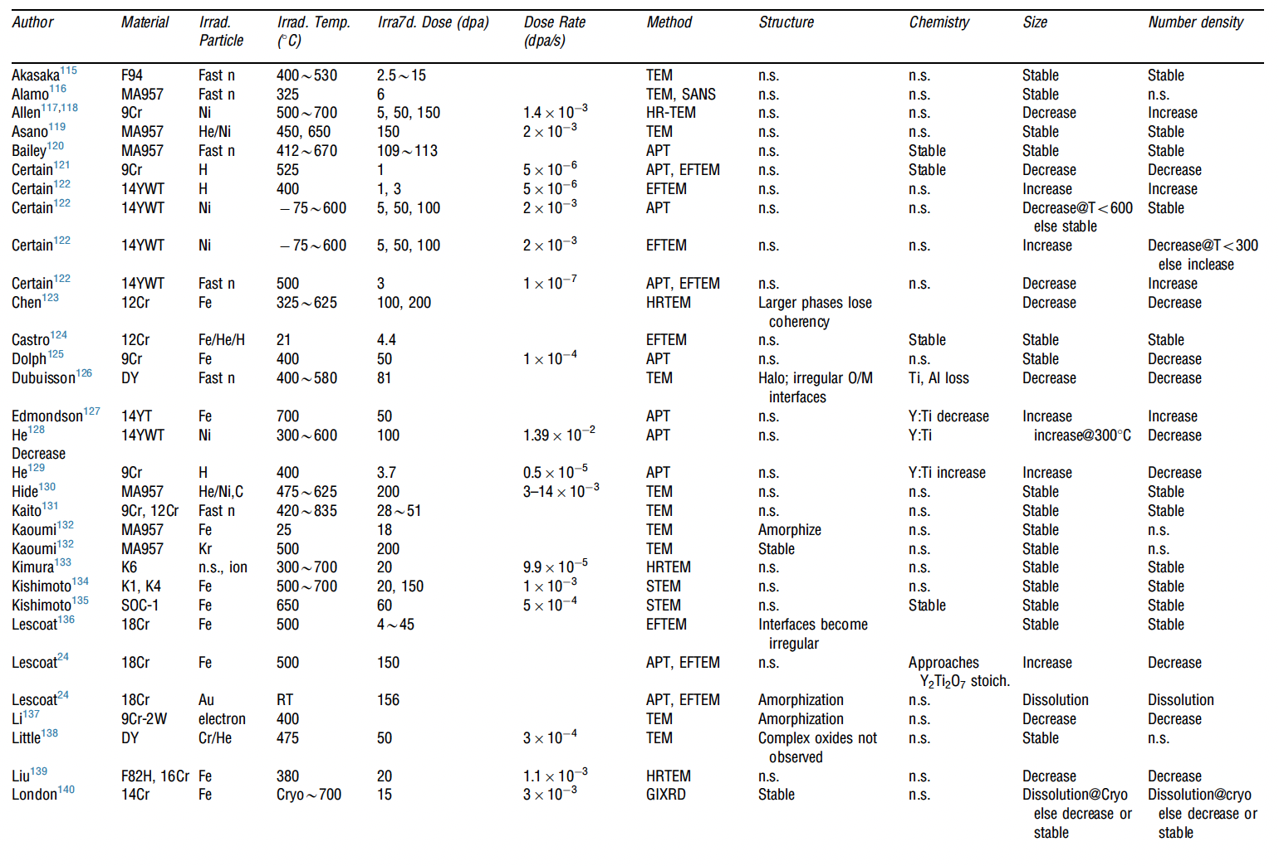
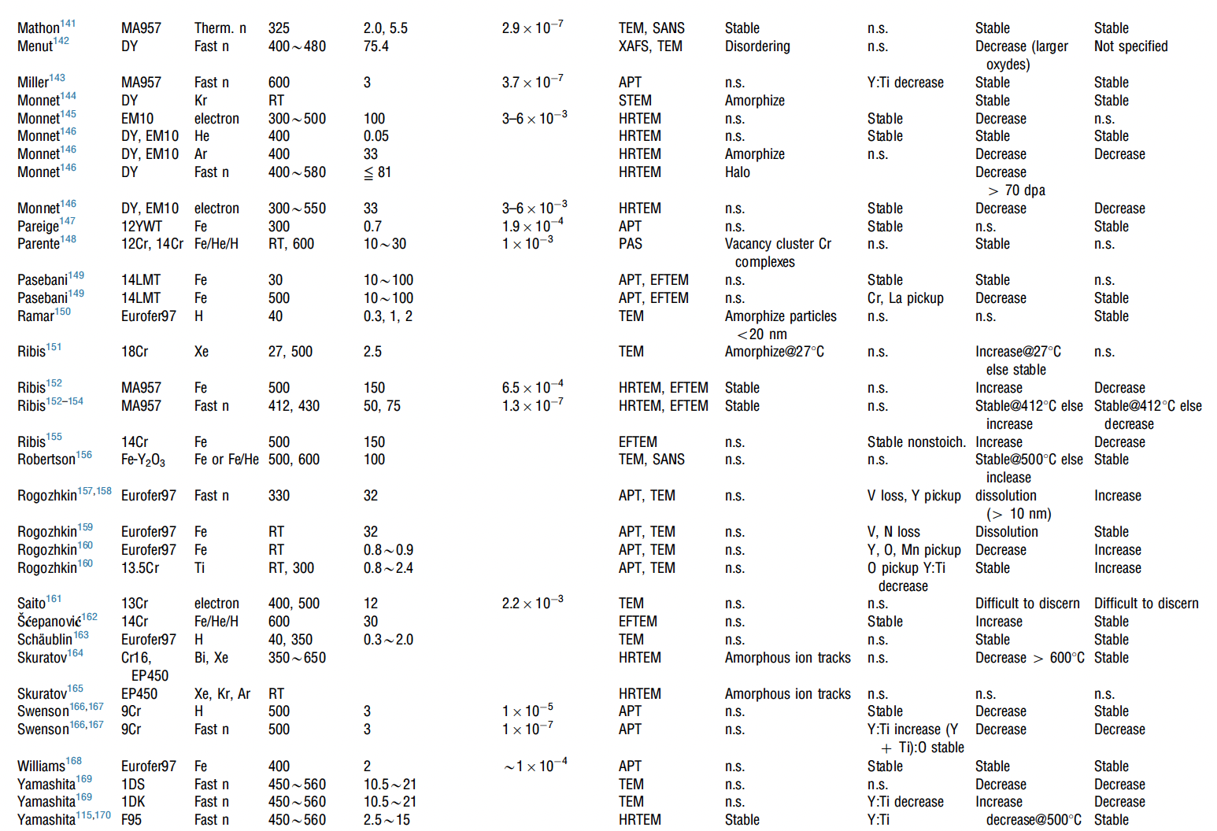
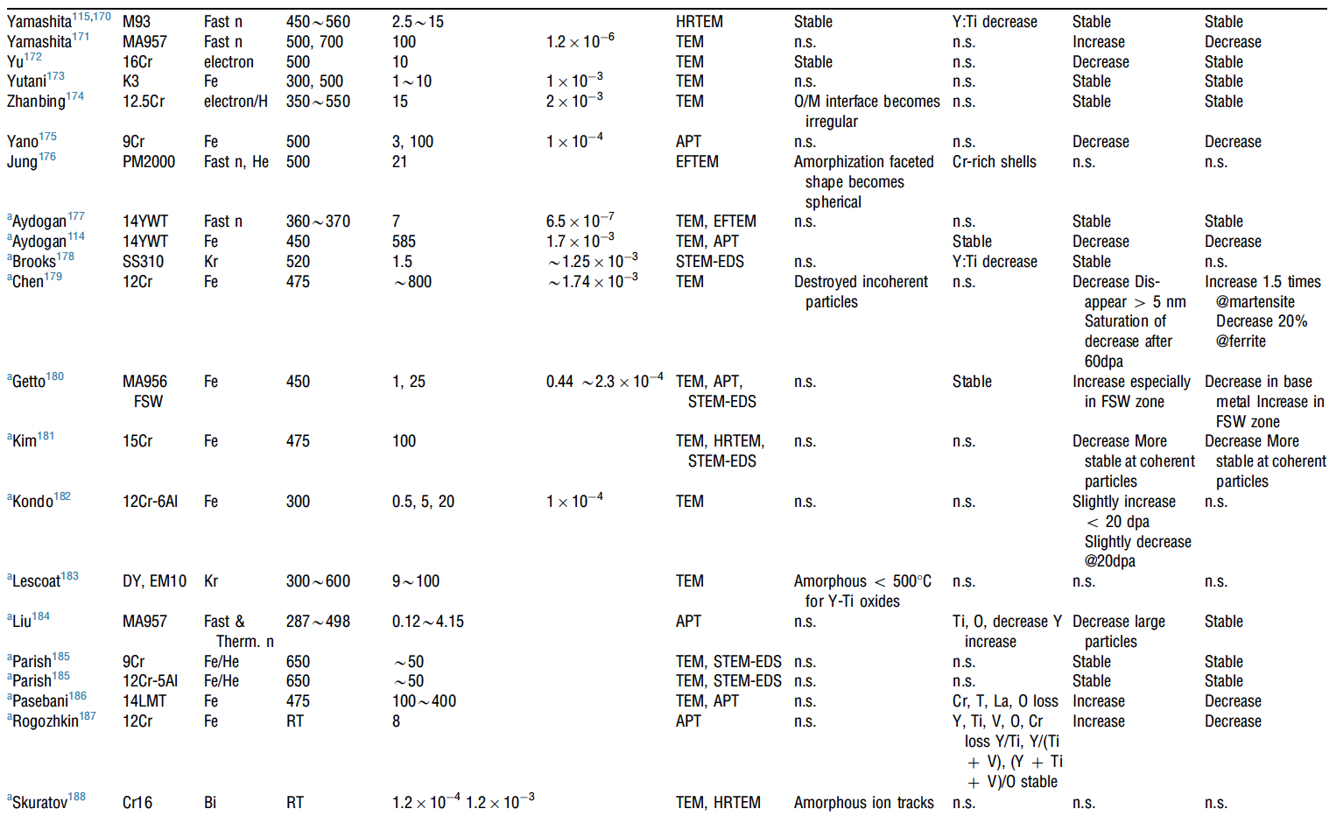
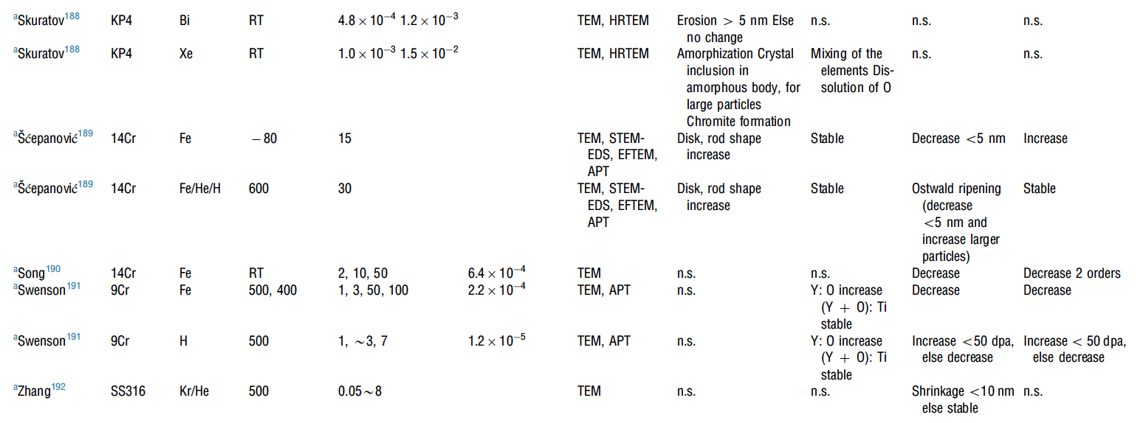
Irradiation Effects
A large number of irradiation experiments have been performed and analyzed to study the evolution of oxide particles
It appears that there is no correlation between irradiation dose, irradiation temperature, and the trend of change in size or number density of oxide particles

Slide 26
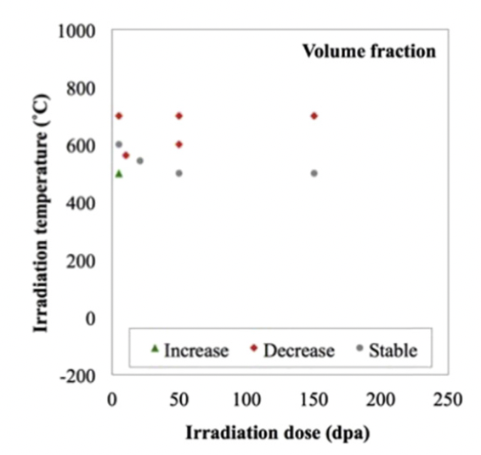
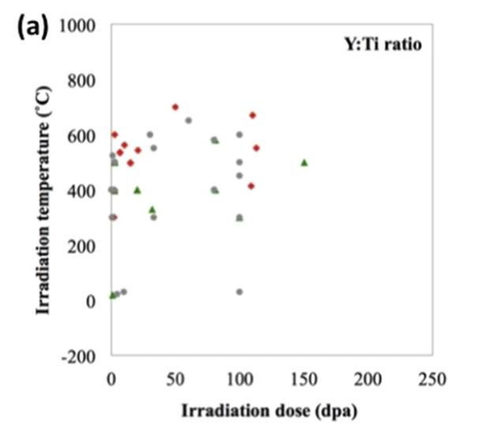
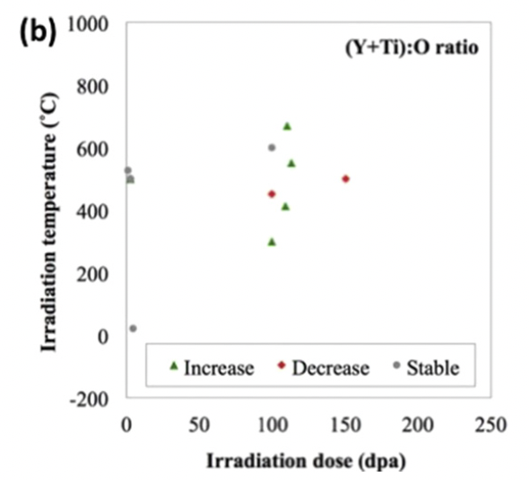
Irradiation Effects
There may be critical temperatures at which the stability of particles and their chemistry are affected
Higher irradiation temperatures may decrease the Y:Ti ratio

Slide 27
Irradiation Effects
Swelling:
ODS steels are very swelling resistant, as the oxide particles trap vacancies and gas atoms, resulting in very small and homogeneously dispersed voids/bubbles
Hardening:
hardness increases due to irradiation in ODS steels are smaller than in non-ODS steels
Oxide particles dominate hardness, and act as sinks for generated point defects

Slide 28
Summary
ODS is fabricated through mechanical alloying and subsequent annealing
9Cr-ODS steel has a unique structure consisting of tempered martensite and residual ferrite that induces superior strength through finely dispersed oxide particles
NFAs have a very high density of oxide particles, producing very high strength and creep resistance, at the cost of workability
FeCrAl-ODS can provide superior corrosion resistance while retaining the ODS influenced mechanical properties
Further in-reactor studies on ODS steels need to be performed
While performance of ODS steels is widely studied, current production is limited to laboratory scale, with prohibitive costs for large scale production

Slide 29
High entropy alloys

Slide 31
Ni alloys

Slide 32
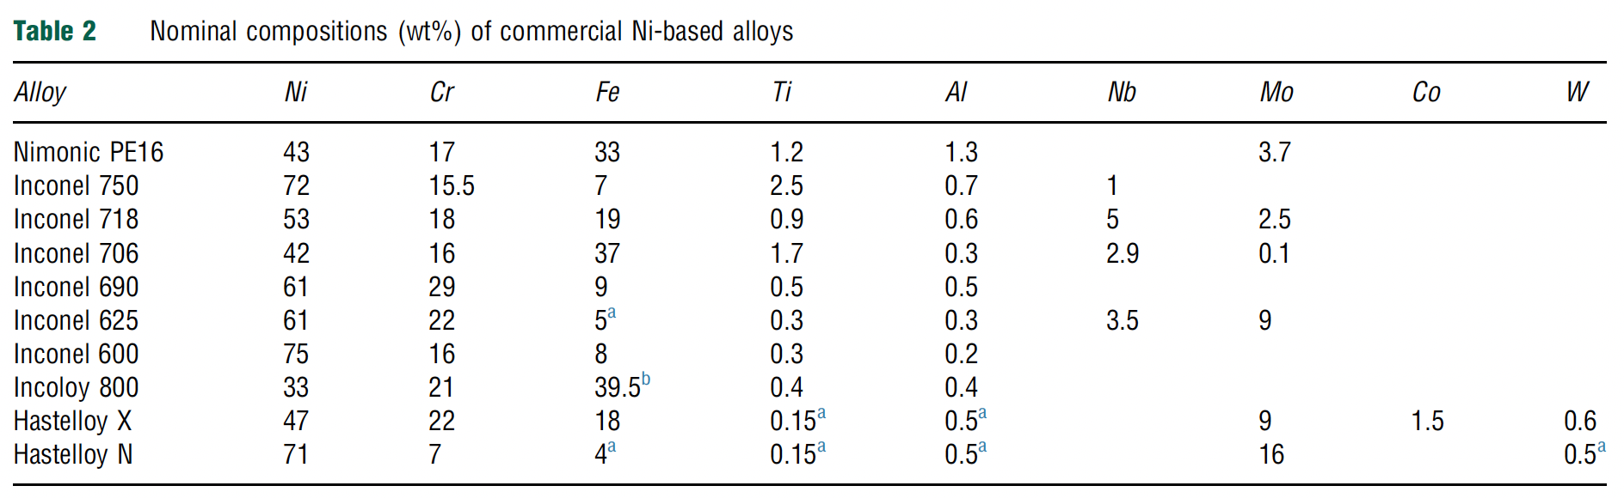
Ni Alloys
Generally resistant to corrosion and display limited mechanical property degradation at high T
Stress corrosion cracking (SCC/IASCC) is a key concern in LWR materials
He embrittlement is of major importance due to the Ni-58 neutron capture cross section which generates He
In fast reactor systems, Fe and Cr can also undergo n,alpha reactions
Ni alloys have been used in LWRs, but mainly in low-dose components, have seen some testing in fast reactors, and are of high interest in advanced reactors

Slide 33
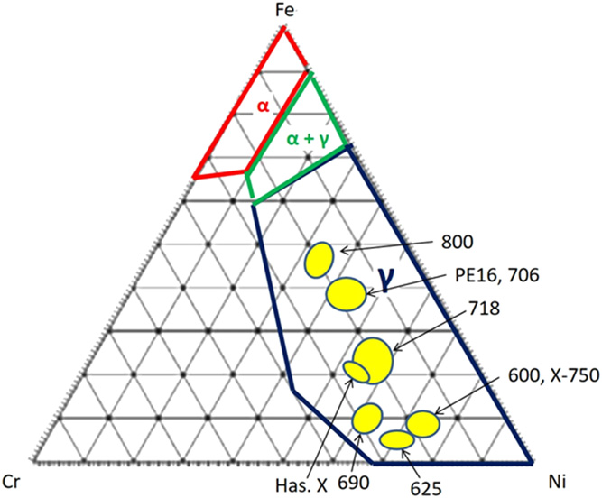
Structures
All commercial Ni alloys are gamma-phase FCC materials
Ternary phase diagram at right at 400C
Ni-alloys by rule have >28 wt% Ni
Fe and Cr are main alloy constitutents, but Al, Ti, Nb, and Mo all have solubility and can be used to solid solution strengthen or precipitation harden
Most alloys are precipitation hardened to increased high temperature creep resistance

Slide 34
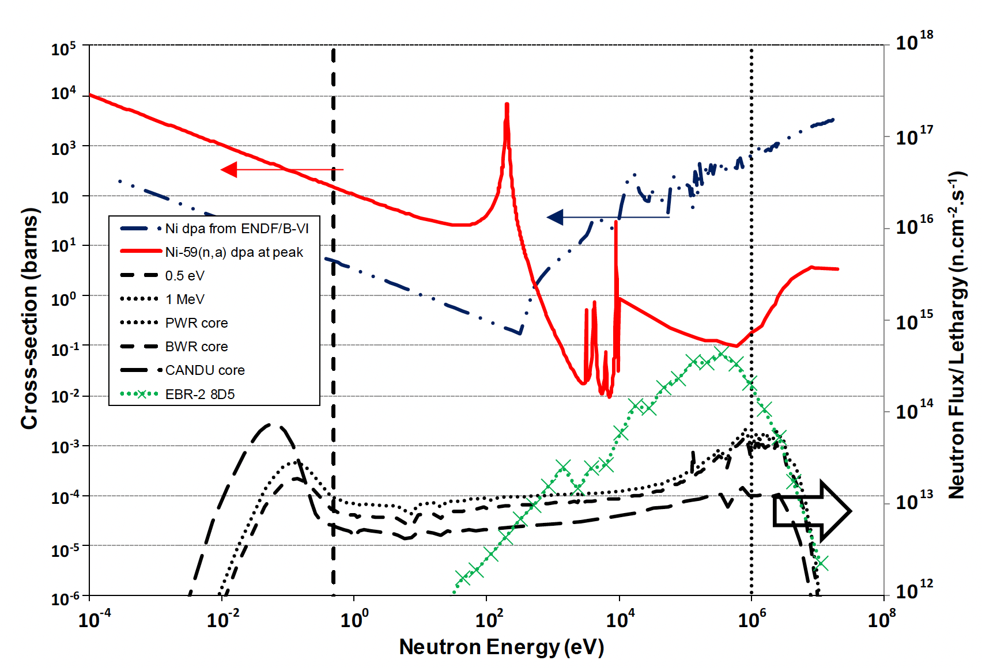
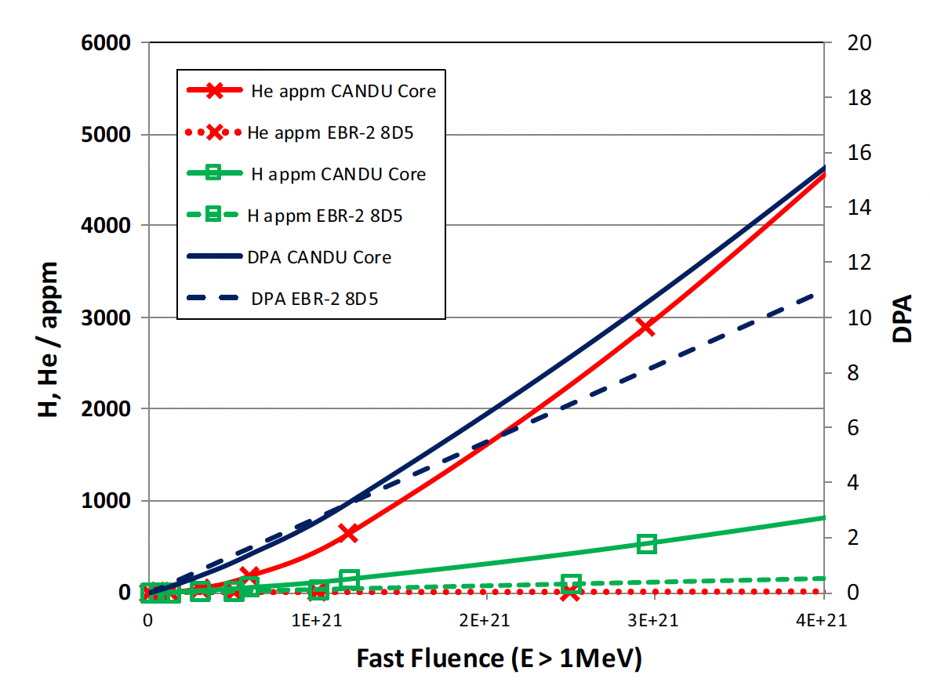
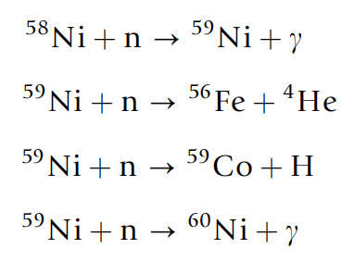
He generation
Large amounts of He and H can be produced due to high neutron dose
Ni alloys in CANDU reactors have a service lifetime of 20 years and can have >20000 appm He
The generation of He is also producing high energy PKAs which are introducing further damage into the system

Slide 35
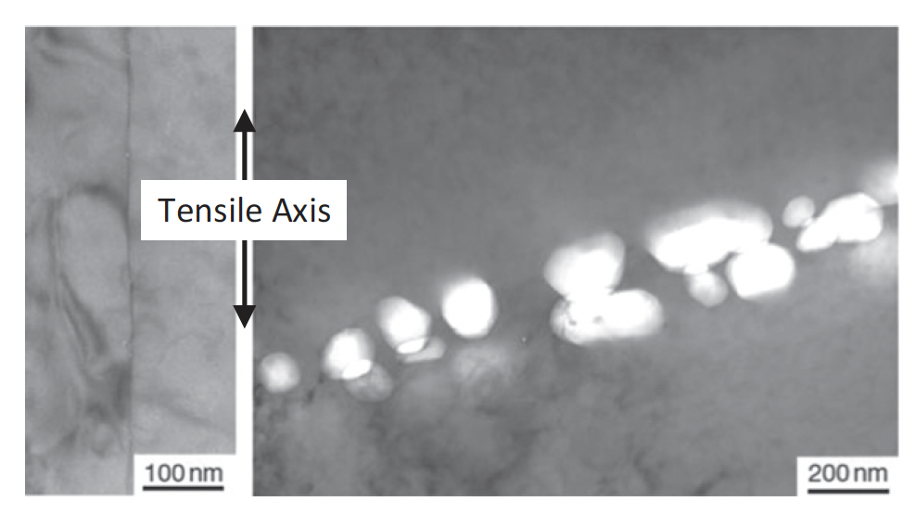
Void Swelling
The concept of void swelling is complicated by the generation of He, in that He bubbles and voids can form separately, or impact each others formation
In fast reactors, He generation is lower, about 1 appm/dpa, but He impacts on grain boundary bubbles have still been identified
Often associated with tensile stresses
Many examples that show high densities of He-stabilized grain boundary cavities in high flux reactors

Slide 36
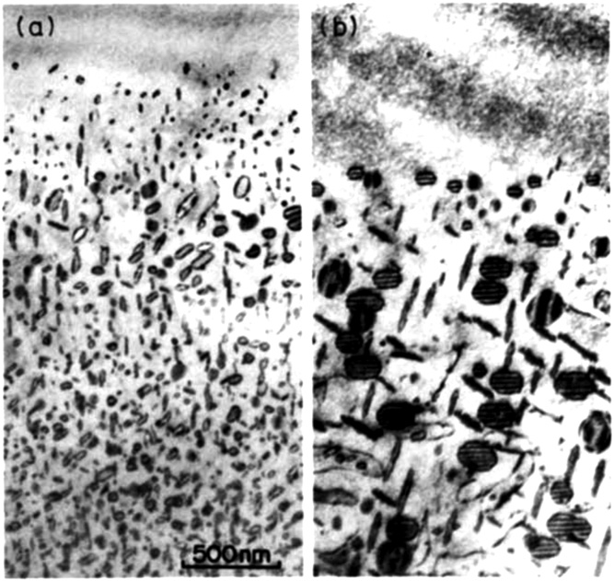
Dislocations
Large dislocation loops are observed at high temperatures expected in advanced reactors
Loop structures have been seen to be very sensitive to temperature controls during irradiation
T ramping
Constant T

Slide 37
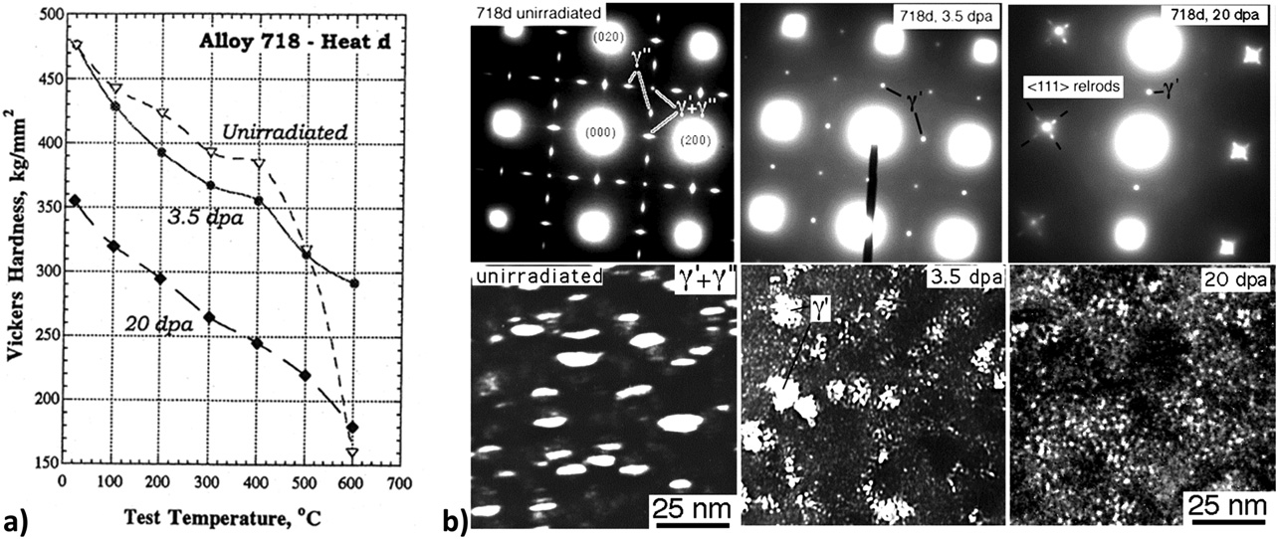
Precipitation
The primary precipitates that form are gamma’ (Ni3Al) and gamma’’ (Ni3Nb-type), where Ni can be replaced by Fe/Cr
These precipitates can be dissolved or dispersed during irradiation
There are competing ballistic and kinetic/thermodynamic factors at play
Higher temperatures allow more rapid diffusion, and the potential re-precipitation

Slide 38
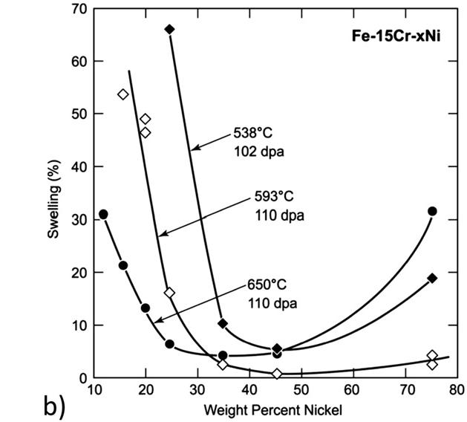
Swelling
Ni alloys generally show significantly improved resistance to swelling compared to SS
The presence of gamma’ precipitates is believed to a factor in the swelling resistance
Alloying species are expected to have the primary effect on swelling behavior, modifying local strain and vacancy biases via the inverse Kirkendall effect
neutron irradiated in a fast reactor to about 100 dpa

Slide 39
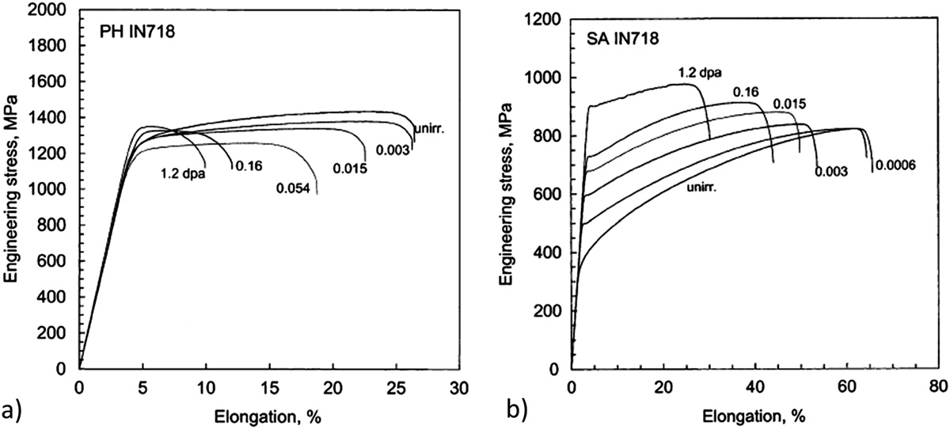
Irradiation Hardening
Ni alloys can generally be categorized into two classes: solution-annealed (SA) or precipitation hardened (PH)
The irradiation response is very different in these two classes
PH materials irradiated at low temperatures (below 100C) and low doses exhibit reduced ductility, but minimal hardening
SA materials exhibit substantial hardening in addition to a reduction in ductility

Slide 40
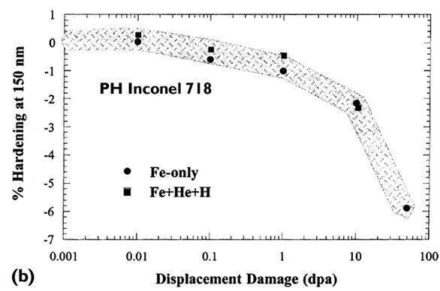
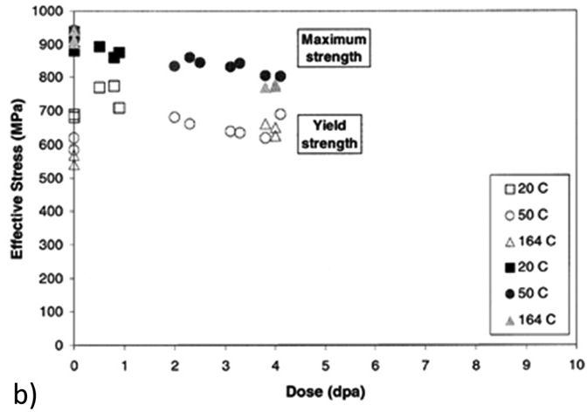
Higher Doses
For PH materials, after an initial increase in RT yield and UTS at low doses, further irradiation can result in a gradual decrease in strength
This has also been seen in PH-SS at elevated temperatures
This does not occur for SA Ni alloys
Softening due to dislocation recovery is likely the effect at high temperatures
At low T, this is likely due to precipitate dissolution

Slide 41
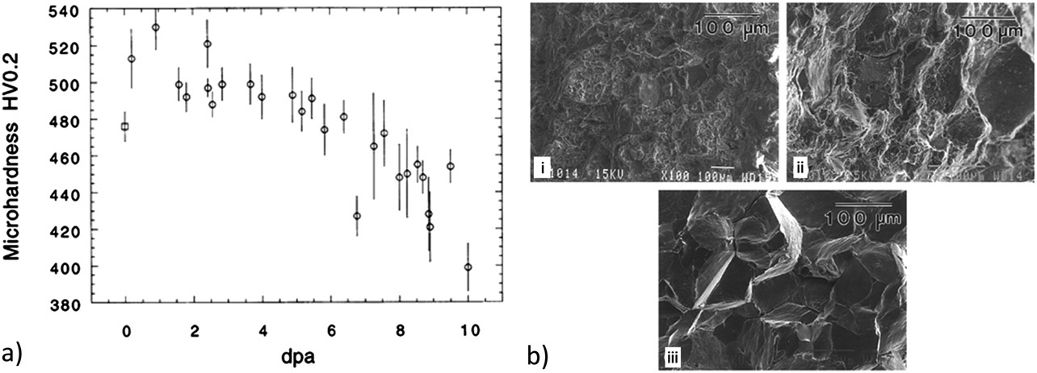
Embrittlement
Despite softening, ductility continues to decrease, embrittling the PH Ni alloy
There is a change from ductile intra-granular to brittle inter-granular failure with increasing dose at low T
This is likely related to He generation, stabilization of He grain boundary bubbles, and embrittlement
Thus, separate phenomena are leading to softening and embrittlement simultaneously
This knowledge base is built on ion irradiations, and some effects may not fully transfer to fast reactor systems

Slide 42
Ni Alloys Summary
Excellent high temperature behaviors, resistant to corrosion, reasonably compatible with molten salt, water, liquid Na
Ni transmutation is an issue which generates He, which can lead to embrittlement (bigger issue in thermal reactors)
Ni alloys are at least 28 wt% Ni, have an FCC phase, are either solid solution strengthened, or precipitation hardened (mostly PH)
gamma’ and gamma’’ precipitates provide strength, hardening, and swelling resistance
Alloys can soften with increased dose due to recovery of cold work at high T, but lose their ductility with increasing dose
Don’t have enough good data on irradiation effects in fast reactor environments

